Slide 1
Merchandise Website
David Hajek, Elisabeth Sykorova, Tymoteusz Walichnowski

Slide 2
Introduction & Theme Rationale

Slide 3
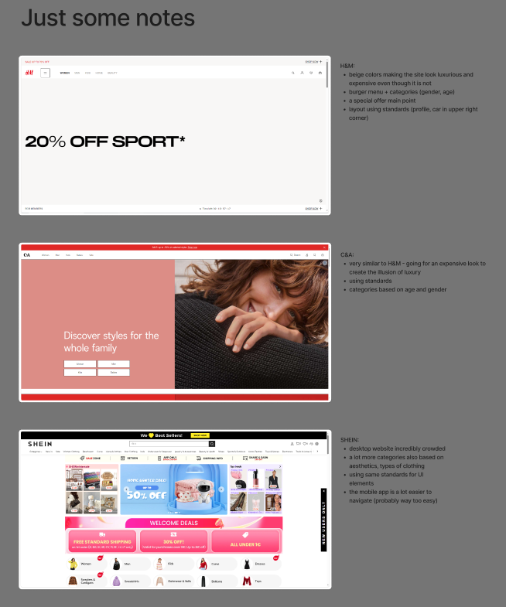
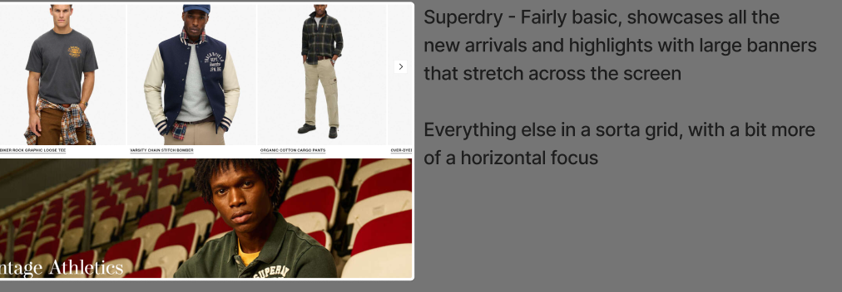
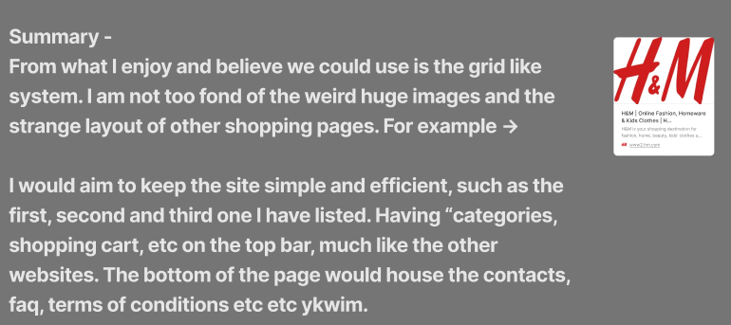
1. Wanted to create a shopping website
- screenshots from our Figma work board

Slide 4
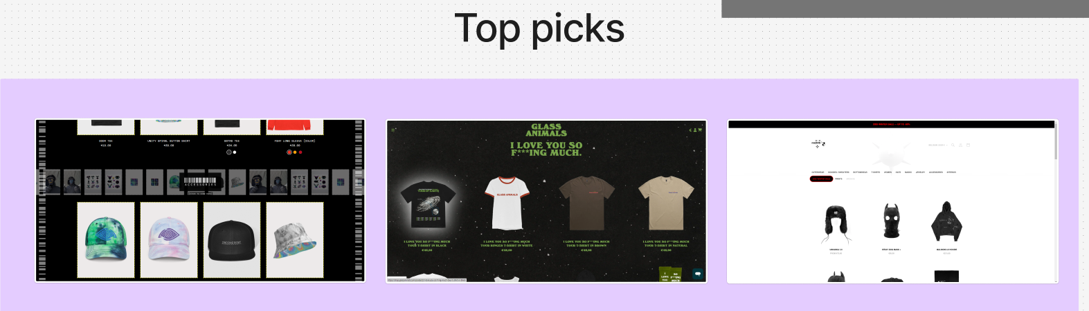
2. Needed a more niche focus
- screenshots from our Figma work board

Slide 5
3. Chosen Theme = Merchandise Website

Slide 6
Research & User Insights

Slide 7
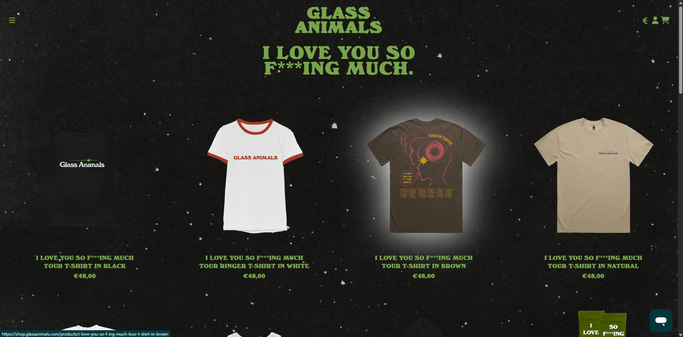
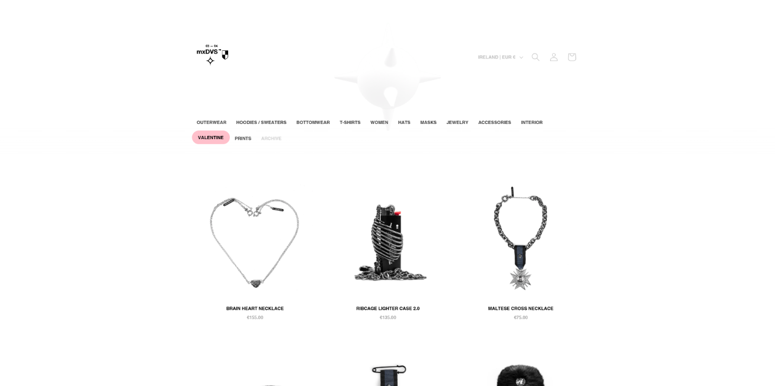
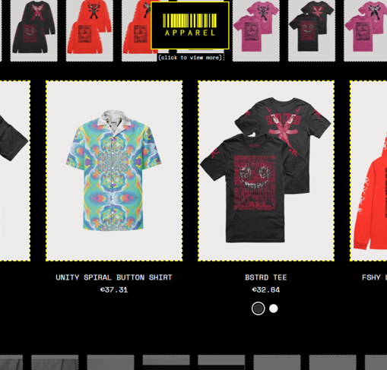
Websites Analysis
1
2
3
https://shop.glassanimals.com/
store.mxdvs.co
corru.store

Slide 8
Analyzed Website 1
https://shop.glassanimals.com/

Slide 9
Analyzed Website 2
store.mxdvs.co

Slide 10
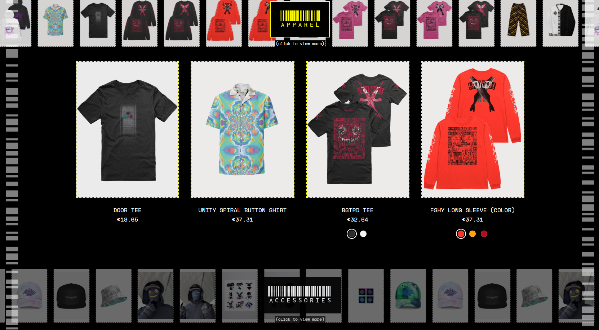
Analyzed Website 3
corru.store

Slide 11
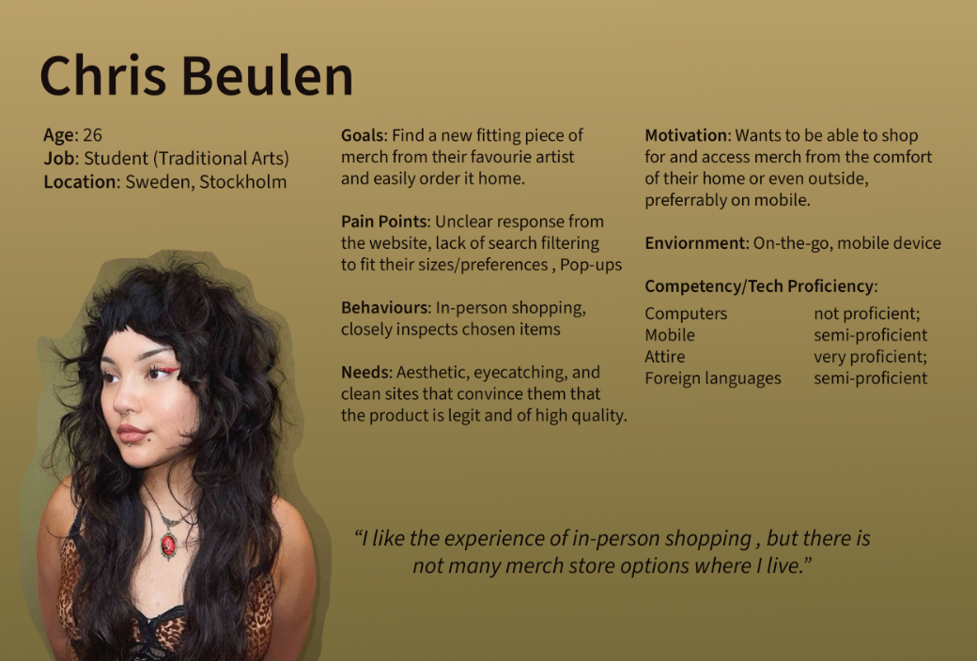
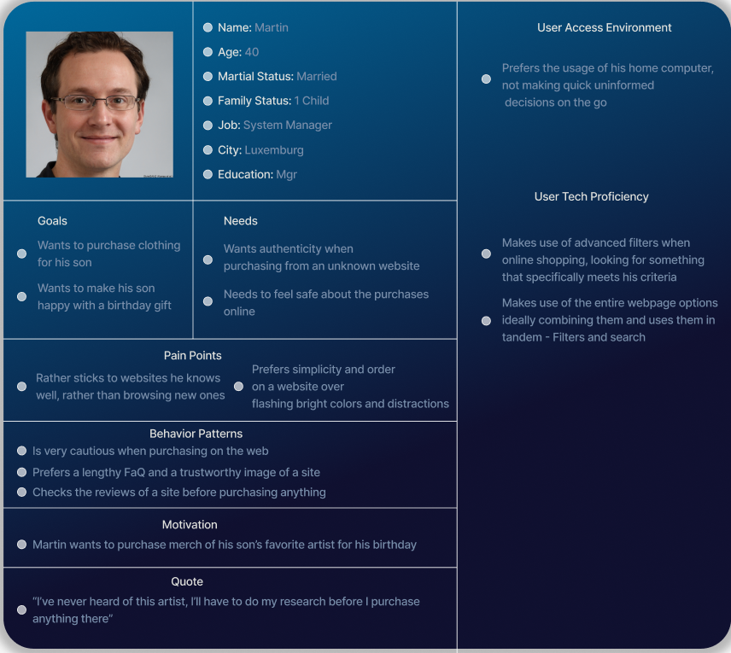
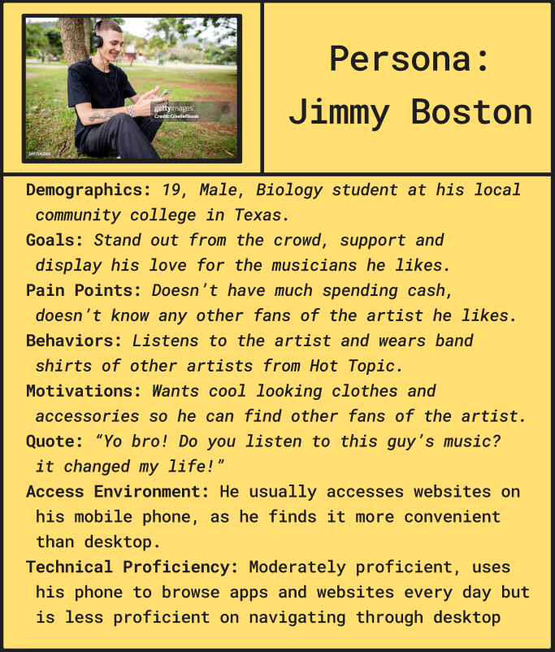
Creating User Personas
1
2
3

Slide 12
User Persona 1

Slide 13
User Persona 2

Slide 14
User Persona 3

Slide 15
Goals & Value Proposition

Slide 16
> Combine the uniqueness and aesthetic appeal of heavily stylized sites that omit accessibility and usability, and the practical aspect of less visually interesting sites that have user-friendly design and features.

Slide 17
Preliminary Designs & Feedback

Slide 18
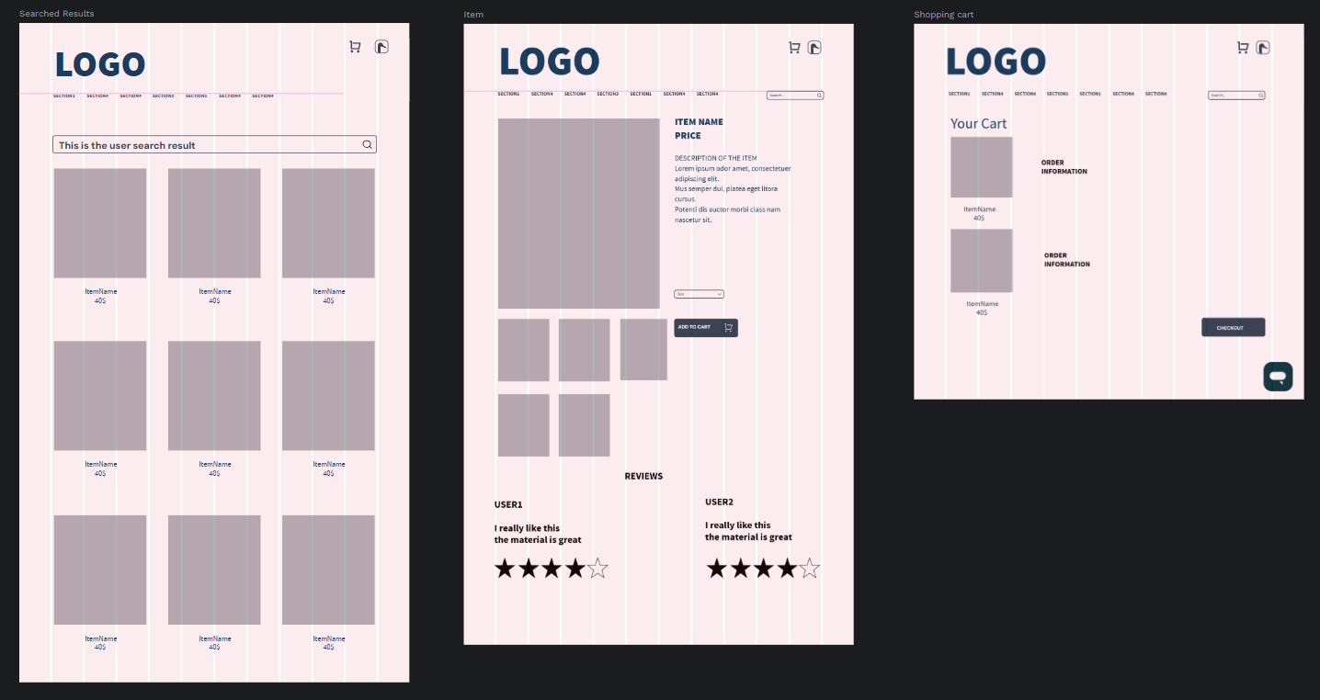
Wireframes
(Penpot)

Slide 19
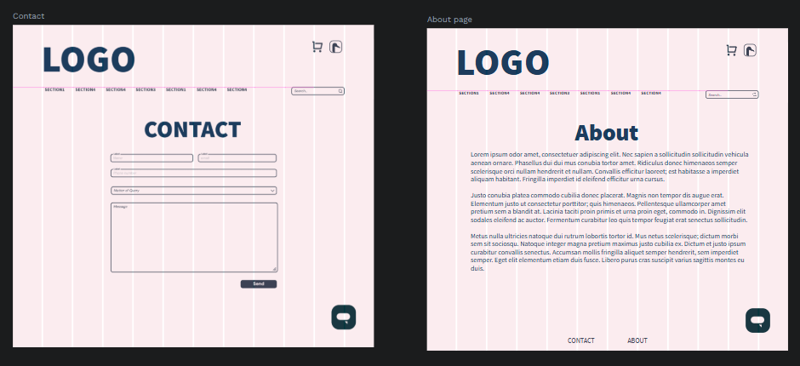
Wireframes
(Penpot)

Slide 20
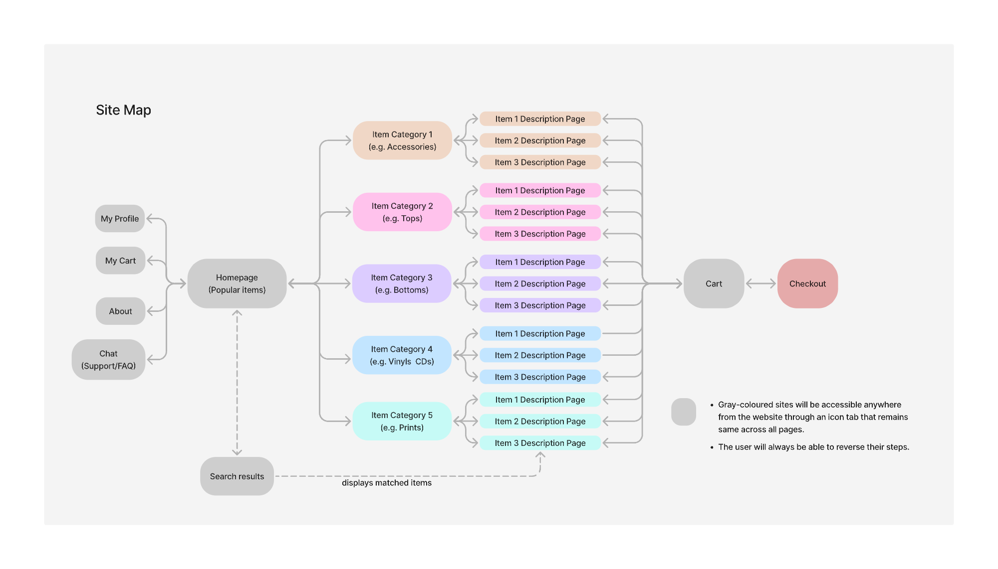
Site Map

Slide 21
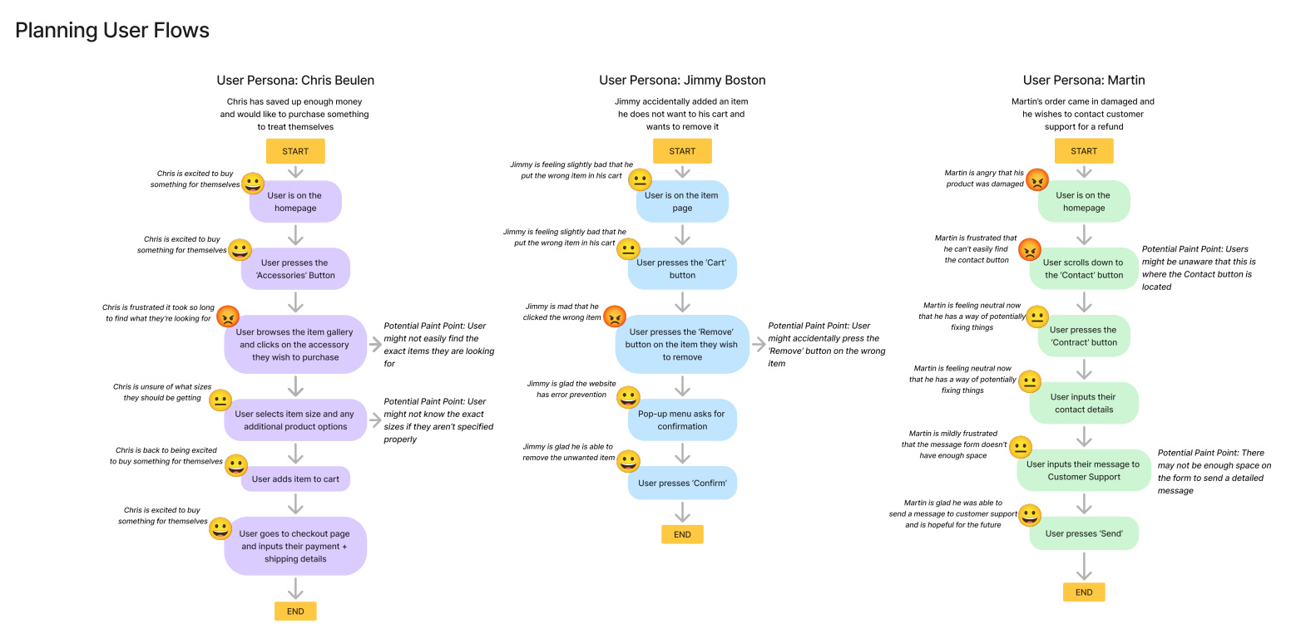
User Flows

Slide 22
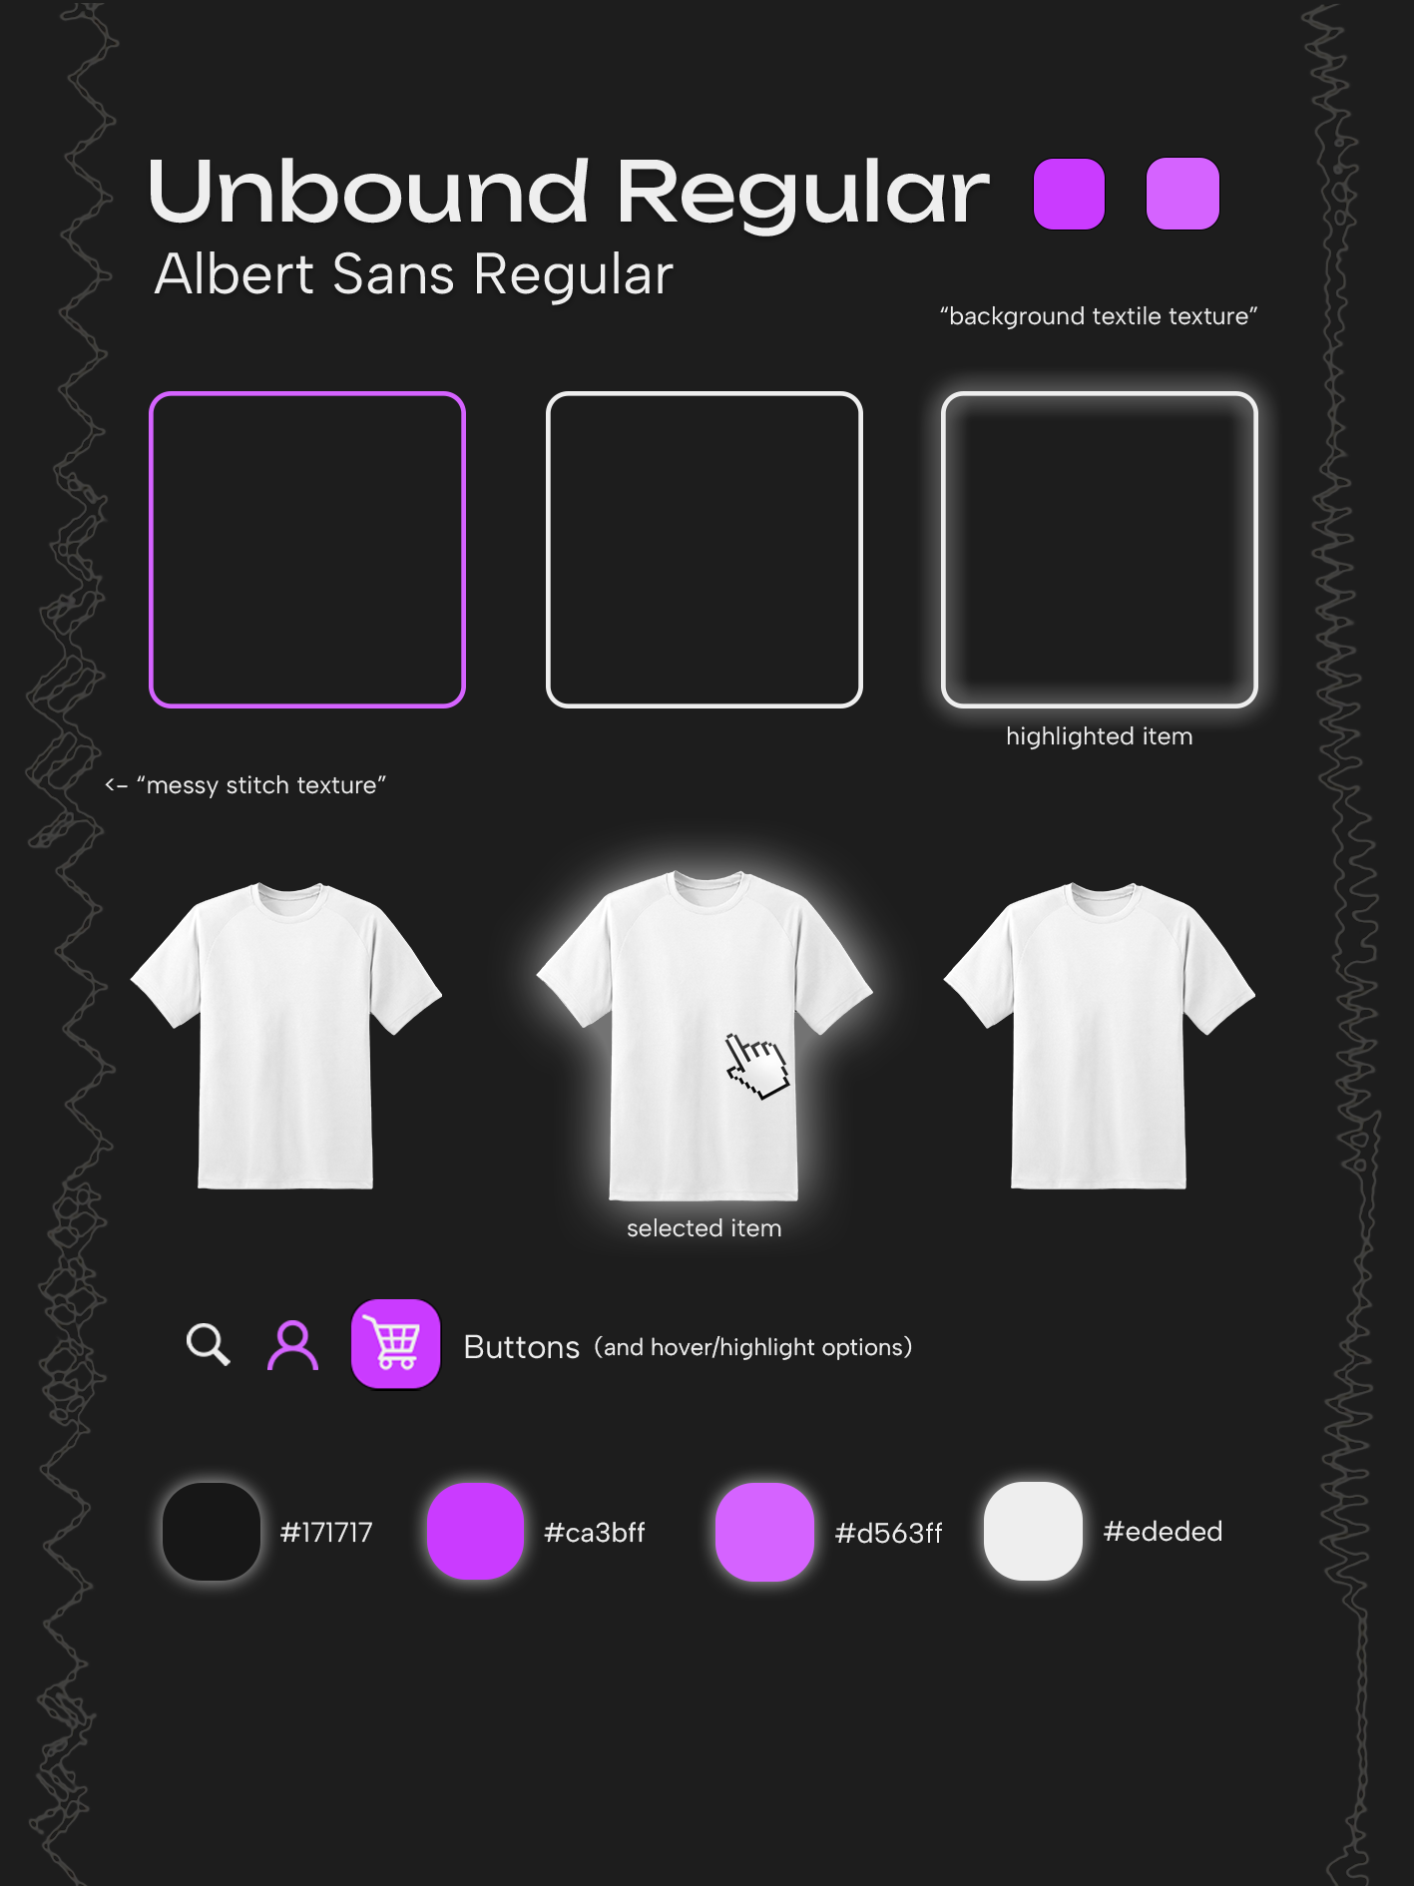
Moodboard

Slide 23
Development & Responsiveness

Slide 24
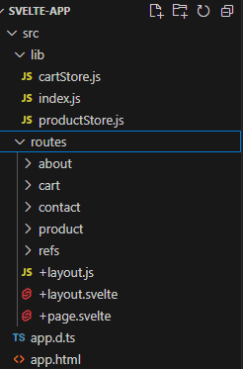
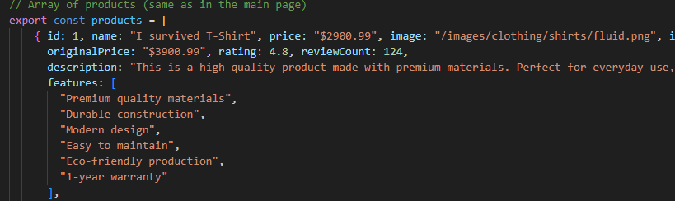
Svelte Setup
Using .JS to store data throughout the store page (products and their info)
Dream setup →

Slide 25
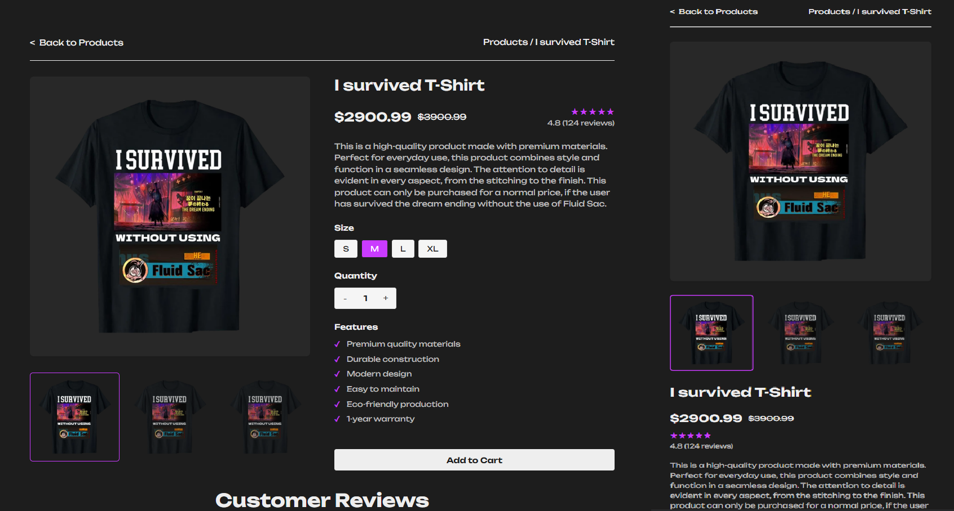
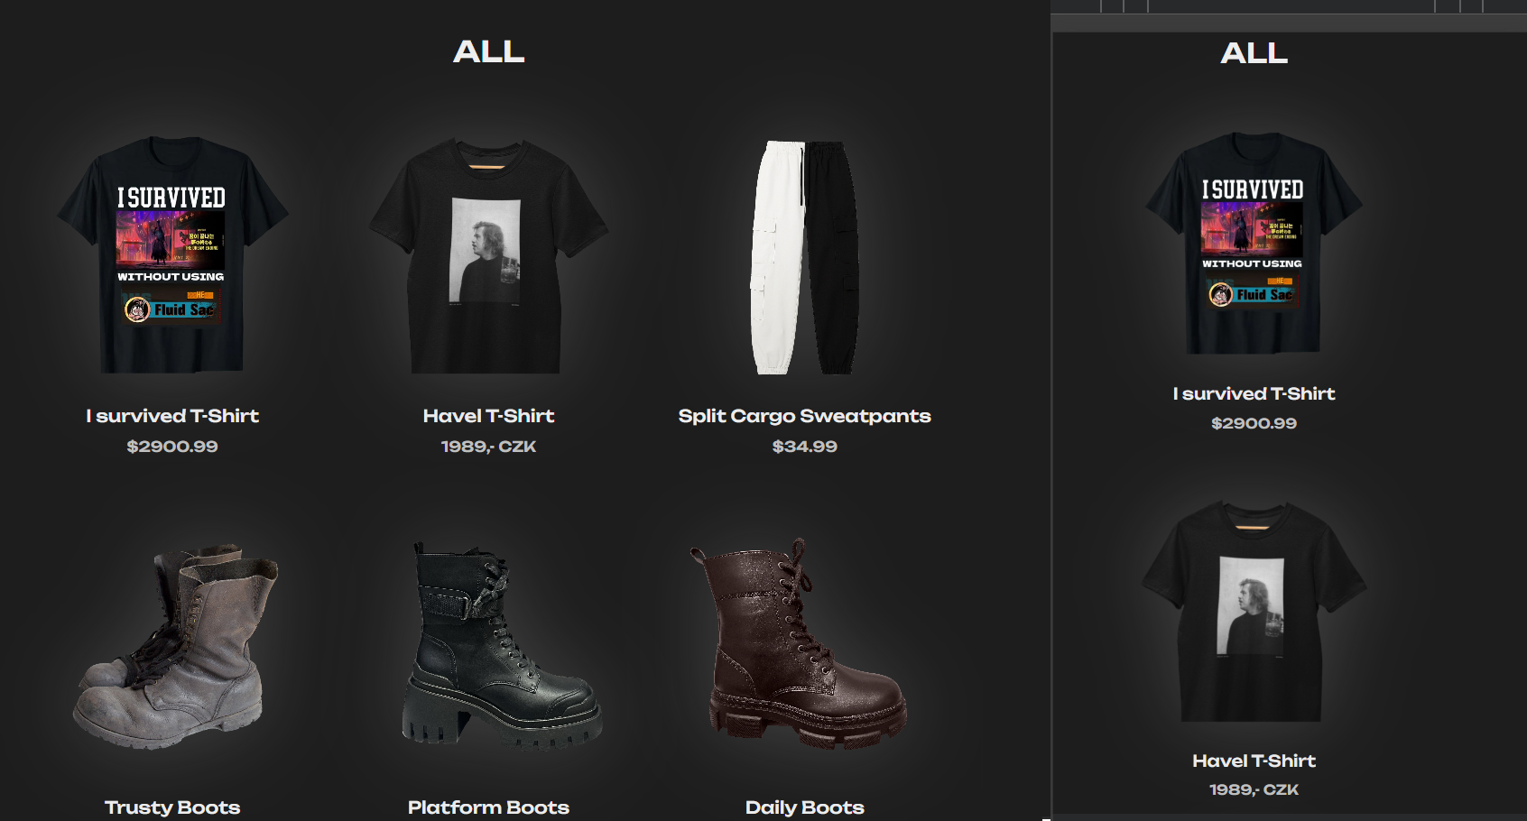
Mobile Layout(s)

Slide 26
Interaction

Slide 29
Testing, Optimisation & Deployment

Slide 30

Usability Tests
We asked classmates to test our website and recorded their responses.
Overall, the results were positive, but a key issues came up:
The navigation scheme was very simple, with all the categories being at the top of the webpage and the about/contact being at the footer
They found it easy to browse the home page for items and find whatever they were searching for, nothing on the site was too visually overstimulating.
They attempted to exit out of the cart tab by clicking outside of it, which is a key feature of many shopping sites that was absent from our own.

Slide 31

Performance Improvements
There weren’t many performance improvements that we had to make while working on the site
The category system -> one home page, that would *filter* items instead of a separate page for each category
A similar system was used for the product page, where we only had one product page, and it would load in the details of whatever the currently selected item was

Slide 32
Deployment
FINAL LIVE URL: https://david-hajek.github.io/Web-UI-Design-Group-Project/
Lessons we Learned
Constant and effective communication is very important when designing website features and implementing them
Svelte can be really finnicky and specific with how it wants you to solve problems
It can be easy to overlook common user design principles
Must have global variables

Slide 33
Reflection & Future Steps

Slide 34
Takeaways and Potential Enhancements
For our next website, we will be more knowledgeable on website deployment for GitHub pages
Having detailed designs pays off!
We will know what to expect from Svelte, and how to handle certain errors when they eventually appear
Have fun while doing it! :)

Slide 35
Thank you for your attention :) – D, E, T

